Slide 1
AMPERES
IP BASED ADDRESS SYSTEM
THE FUTURE STARTS HERE

Slide 2
FUNDAMENTALS
Amperes IP Based PA: iPX Series
Transmission of Audio Paging and Controls via TCP/IP using LAN, in which :
Audio includes Voice or Music with format such as ADPCM, MP3, WAV etc
Controls include RS485 data or any other approriate data
The Power of Visual Charts
conversion to TCI/IP
audio and data
transmission in
LAN / Fiber

Slide 3
ADVANTAGES OF IPX SERIES
SINGLE NETWORK CONNECTION
LESS CABLINGS
VOLTAGE DROP AVOIDED
less cablings as compared to conventional systems for system interlink.
long distance voltage drop (cabling loss) avoided
able to link large systems in a single network
BIDERECTIONAL
CONNECTION
WIRELESS
CONNECTION
allows bidirectional paging and controls.
allows bidirectional paging and controls.

Slide 4
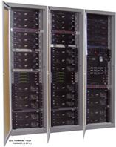
1
SINGLE NETWORK CONNECTION
ADVANTAGES OF IPX SERIES
able to link large systems in a single network
expandable for future expansion
Main system
Sub-systems
Further sub link

Slide 5
2
LESS CABLINGS
ADVANTAGES OF IPX SERIES
less cablings as compared to conventional systems for system interlink
Sub-systems
Main system
Fiber link to sub systems
Examples: Sub System with 20 zones ; cable requirements as below:
20 x 2 Core 2.5mm or higher size
2 x 2 Core 2.5 for 24V DC
overriding
2 Pair screen cable for audio
2 Pair screen for data
Outdoor cablings ( armoured )
2 Core Fiber ( SM / MM )
or
Not Required if existing LAN used

Slide 6
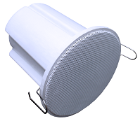
3
VOLTAGE DROP AVOIDED
ADVANTAGES OF IPX SERIES
long distance voltage drop (cabling loss) avoided
Main system
Speakers in Sub-buildings
2.5mm cable
Reference : Cable loss table for various cable sizes
Cable length subjected to :
permissible total loss
total load
cable size
Loss calculator available in webpage such as
https://www.tlcdirect.co.uk/Technical/Charts/VoltageDrop.html

Slide 7
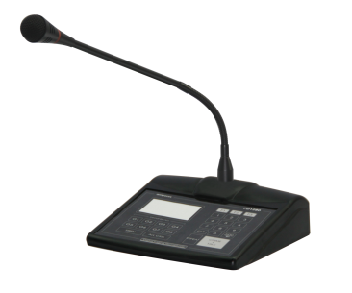
4
BIDIRECTIONAL CONNECTION
ADVANTAGES OF IPX SERIES
allows bidirectional paging and controls.
Main system
Speakers in Sub-buildings
Conventional Hardwired
IP System
Only local paging
and zone controls allowed
main system able to
page local and sub
Controls include remote monitoring, zone controls and other settings

Slide 8
5
WIRELESS CONNECTION
ADVANTAGES OF IPX SERIES
Wireless connectivity solutions
Main system
Sub systems
When hardwiring not possible, long distance wireless transmission is
more economical than laying cable
WIFI router
Point to Point wireless link

Slide 9
DISADVANTAGES
Network Crash
Latency
Costs
small latency as compared to direct connection from audio output
Possible network crash if using
existing LAN and other difficulty in managed network system such as firewall
settings
It is more costly for smaller
system with single rack as compared to larger distributed systems
miliseconds latency can be easily unnoticed
Use dedicated network / fiber link for PA or related ELV system ; apart from office main network
On equipment wise, Amperes offers the most economical solution as compared to others of similar range

Slide 10
WHAT AMPERES IP CAN OFFER
Conversion of existing analogue / digital system into IP at a fraction of cost without much change to the setup
1
Less proprierty equipment, SDK available for external interface
2
Communication breakdown in LAN would not affect local operation
3
Modular ; only install related equipment according to requirement
4

Slide 11
TYPES OF INSTALLATIONS
IPX SERIES : BUILDING A SYSTEM
CENTRALISED SYSTEMS WITH INDIVIDUAL ZONE CONTROLS
DECENTRALISED ZONE CONTROLS
WIRELESS TRANSMISSION

Slide 12
1
DECENTRALISED SYSTEMS WITH INDIVIDUAL ZONE CONTROLS
TYPES OF INSTALLATIONS
Visualization
FEATURES
Main System with own paging mic which can page to anywhere including emergency voice paging, broadcast music and auto message playback
Sub block 1
Main block FCC
Sub System with optional paging mic and each block sub divided into more than one zone
Sub block 2
Sub systems are allowed to page to anywhere or only to local area, including emergency paging.
Every system shall have own UPS
Sub block 3
All systems are connected via dedicated fiber / LAN

Slide 13
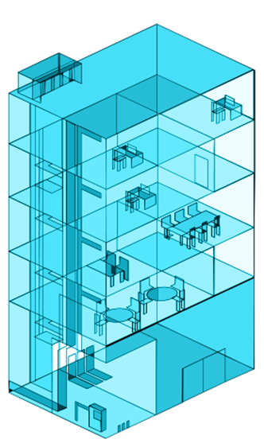
2
DECENTRALISED ZONE CONTROLS
TYPES OF INSTALLATIONS
Visualization
FEATURES
Main System able to page to all areas with all controls located in the rack
Sub rack 2
Sub system located at risers with or without zone controls
No paging mic at sub system / sub floors, and this can be added if required via networked paging mic.
Sub rack 1
Every system shall have own UPS
All systems are connected via dedicated fiber / LAN
Main rack at FCC

Slide 14
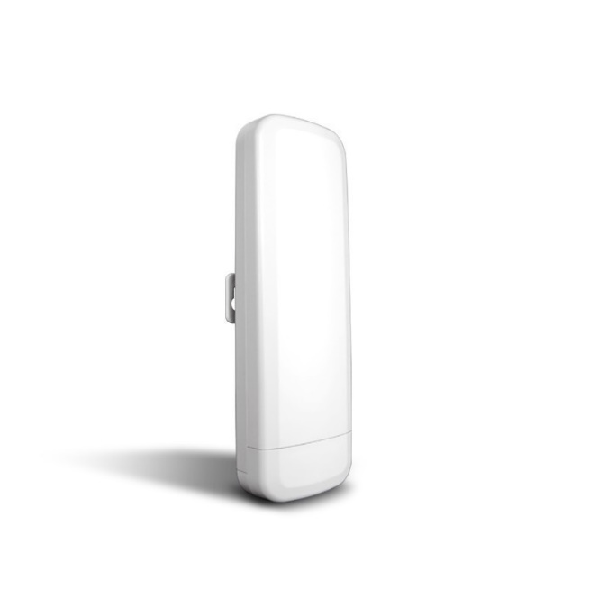
3
WIRELESS TRANSMISSION
TYPES OF INSTALLATIONS
Visualization
FEATURES
Remote sounder
Main system
Main System able to page to all areas with all controls located in the rack
Sub system with zone or without zone controls. Can easily interface with other sound devices
Every system shall have own UPS
Remote system connected via WIFI routers / AP Link
Wireless AP link

Slide 16
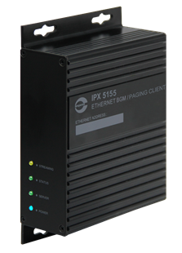
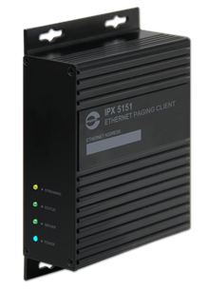
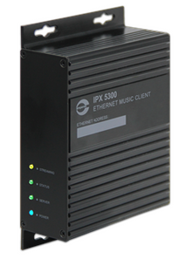
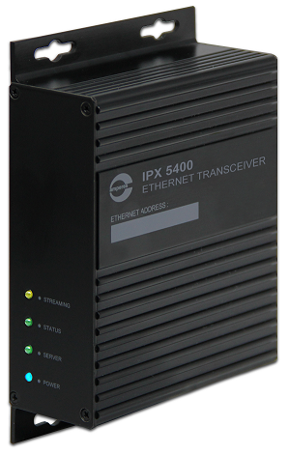
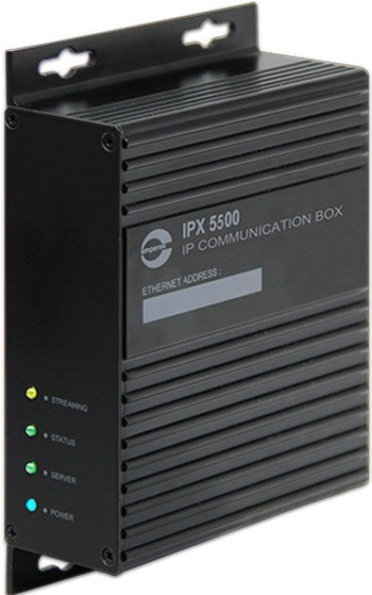
IP PRODUCTS : OVERVIEW
IPX SERIES : PRODUCTS
iPX5101 Network Controller
iPX5200 Network Music Server
01
02
iPX5151
Network Paging Client
iPX5155
Network Paging / BGM Client
iPX5300
Network Music Client
03
04
05
07
iPX5500
UART to IP Converter
IPX5400
Network Audio / Data Transceiver
06

Slide 17
1
IPX5101 NETWORK CONTROLLER
IPX SERIES : PRODUCTS
FUNCTIONS
Traffic controller for all iP Paging devices connected in the network. Among key functions are :
Registering all paging clients
Identifying priority levels for all active microphones and rerouting / activating or deactivate paging consoles and zone selectors via iP paging clients
Only 1 unit required per system
LAN

Slide 18
2
IPX5200 NETWORK MUSIC SERVER
IPX SERIES : PRODUCTS
Music source (Line Input)
FUNCTIONS
Accepts analouge music source and converts the selected source to TCP / IP
1
2
3
4
Also accept SD Card with multiple audio format
Consists of 8 group of clients for music target. Each group can have up to 8 clients
Only 1 unit required per system
SD
CARD
LAN

Slide 19
3
IPX5151 NETWORK PAGING CLIENT
IPX SERIES : PRODUCTS
Data
Audio
FUNCTIONS
Converts incoming audio and data into TCP / IP
For PD series paging microphone and EP1200 emergency paging panel
Each mic with 1 client
Can also be used as receiving, for receving paging signal only
LAN

Slide 20
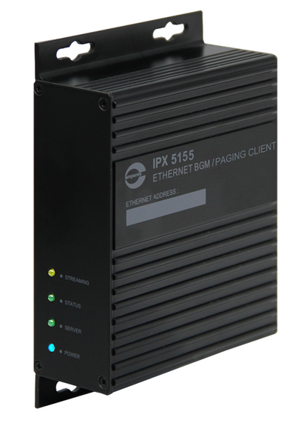
4
IPX5155 NETWORK PAGING / BGM CLIENT
IPX SERIES : PRODUCTS
Audio
Data
FUNCTIONS
Converts incoming data into music / paging output and RS485 data for controls
Priority for paging ; mute music when paging is active
Volume, bass and treble setting via browser
1 unit per rack / sub system ; if multiple music required, additional unit can be added
LAN

Slide 21
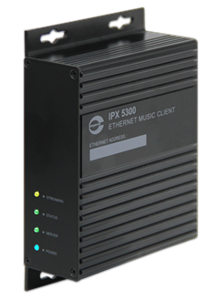
5
IPX5300 NETWORK MUSIC CLIENT
IPX SERIES : PRODUCTS
FUNCTIONS
LAN
Dedicated music client
Use in uninterrupted paging system ; also suitable for high quality audio streaming of up to 320 kbps mp3
BGM Output

Slide 22
6
IPX5500 UART TO IP CONVERTER
IPX SERIES : PRODUCTS
FUNCTIONS
RS485 data interface for TCP / IP communication.
LAN
Bidirectional UART data communication ; receive data from remote deivces such as battery charger for monitoring over PMX LAN software. Controls of QP power amp from remote PC
Each unit able to connect up to 16 devices
RS485 data

Slide 23
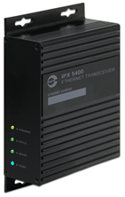
7
IPX5400 NETWORK AUDIO / DATA TRANSCEIVER
IPX SERIES : PRODUCTS
FUNCTIONS
Peer to Peer Audio & Data Transceiver for Paging Mic
Sending P-P high quality music audio via network
Applicable when Paging Mic is located far away from Central system, to avoid laying copper cable which is subjected to surge and noise.
LAN
Transmission through existing LAN network or Fiber link via Fiber Converter. Allows direct cable connection without network switch
Audio & Data
( One Way for Music )
Audio & Data
( One Way for Music )

Slide 24
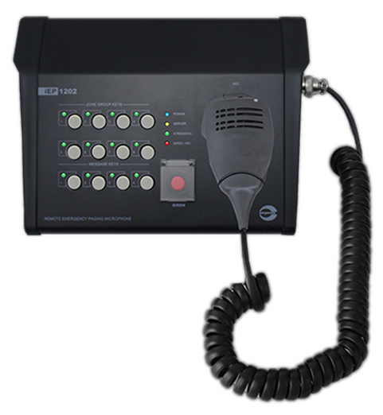
IP PRODUCTS : OVERVIEW
IEP SERIES : PRODUCTS
iEP1200
Network Emergency Paging Mic
01
iEP1202
Network Remote Emergency Paging Mic
02

Slide 25
1
IEP1200 NETWORK EMERGENCY PAGING MIC
IEP SERIES : PRODUCTS
F16000
Emergency Contact
FUNCTIONS
MR1301
Audio Input
Emergency paging to all Paging and Music Clients ; overriding BGM / normal paging in progress
Interface to fire alarm panel and voice message delivery as emergency announcement
May install several units in a system ( for different locations )
LAN

Slide 26
2
IEP1202 NETWORK REMOTE EMERGENCY PAGING MIC
IEP SERIES : PRODUCTS
FUNCTIONS
Desktop version of Emergency Paging Mic, suitable for remote locations such as Guard House, Security Desk, Wall Stations etc.
Programmable zone grouping and with built in pre-recorded voice message player, siren tone generator
Handheld paging mic or gooseneck version available upon request
LAN

Slide 27
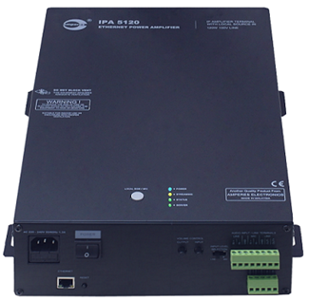
IPA5060/ 5120
NETWORK AMPLIFIER TERMINAL
IPA SERIES : PRODUCTS
FUNCTIONS
LAN
Remote IP amplifier with 60 / 120W 100V Line output
Local mic / line input for local music broadcast / paging
Allows emergency / priority paging from central PA system to bypass local audio source
Applications include Classrooms, Ticketing Stations, Function Rooms, Restaurants, etc
Local Mic / Line Input
Local speakers

Slide 28
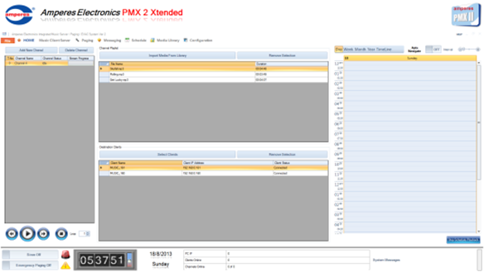
PMX LAN SOFTWARE
PMX SOFTWARE
FUNCTIONS
Music, Scheduling, Messages, PC Paging and equipment monitoring and controls
Touch screen PC can be used
PC with Windows 8 / Touch Screen PC
Front Page Interface

Slide 29
UPCOMING IP PRODUCTS
... We keep innovating
IP SERIES : PRODUCTS
15W horn speaker suitable for indoor and outdoor
IP PoE Horn Speakers
IP PoE Full Range Speakers
20W full range speakers with POE adaptor
Rack mounted IP amplifier with various power ratings
IP Power Amplifier
Small to medium power IP amplifier terminals for decentralised systems
IP Remote Amp Terminal

Slide 30
OTHERS WITH LAN INTERFACE
... We keep innovating
IP SERIES : PRODUCTS
MatriMix MxP2288
12x8 Matrix controller with LAN interface for setting and controls
EVAC Message Player
Upgraded from MR1301 with more features and ease of programming
Setting made easier with LAN interface with better user experience
Program Timer
Fire Alarm Interface
Expanded fire alarm interface with expanded inputs and easier programming with simplified UI

Slide 31
AMPERES
IP BASED ADDRESS SYSTEM
THE FUTURE STARTS HERE

