Slide 1
Phased Evacuation with Amperes FI6000
Fire alarm interface panel

Slide 2
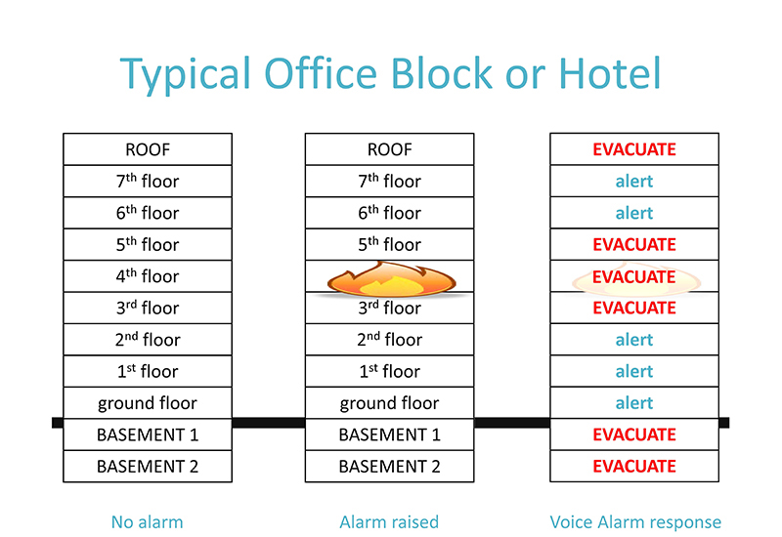
What is Phased Evacuation
systematic removal of people from an area, floor or building during an emergency such as a fire. ... the evacuation of a building, it is possible to ensure that those in the most danger are able to escape first.

Slide 3
Amperes FI6000 - Fire Alarm Interface for Phased Evacuation
USB Interface for
programming
24 LEDs for showing activation from external devices such as dry contact from FAS
Dry contact indicator for activation of external devices such as message recorder, vol control overriding etc

Slide 4
Amperes FI6000 - Fire Alarm Interface for Phased Evacuation
RS485 Communication Port to Control External Devices such as Zone Decoder etc
24 ports available for connections to FAS dry contact .. Unit can be cascaded if total zones exceeds 24 channels
4 Dry Contacts to activate non UART controlled devices

Slide 5
Amperes FI6000 - General Connections
DRY CONTACTS FROM FAS
AUDIO SOURCES FROM BGM OR PAGING MIC THRU MIXER
Data to Trigger Message type
Audio + Message Bypass
Audio
Data to trigger specifice zone / zones
100V Line
SPEAKER ZONES

Slide 6
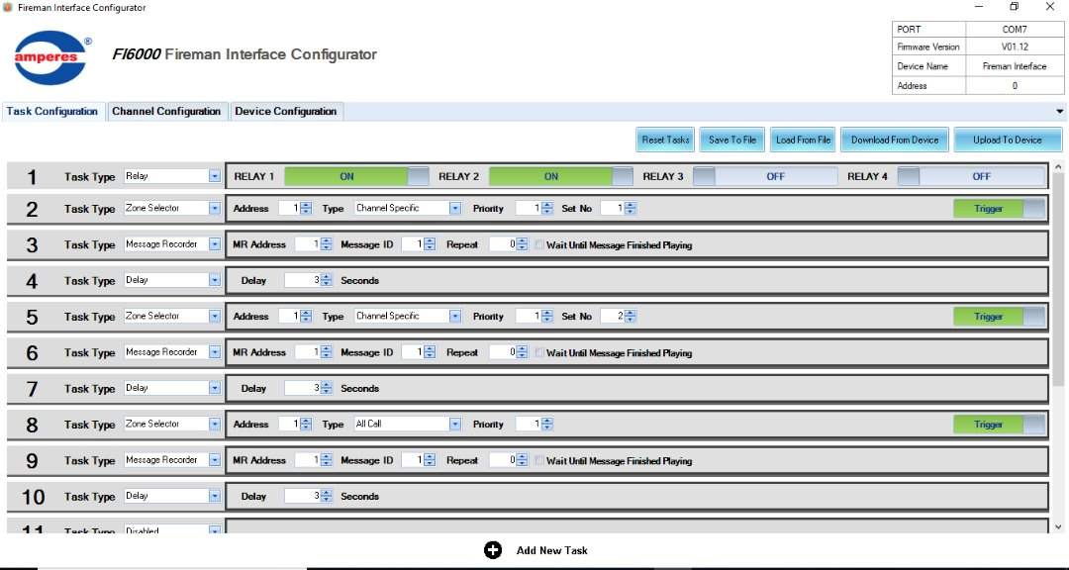
Amperes FI6000 - Programming Tasks

Slide 7
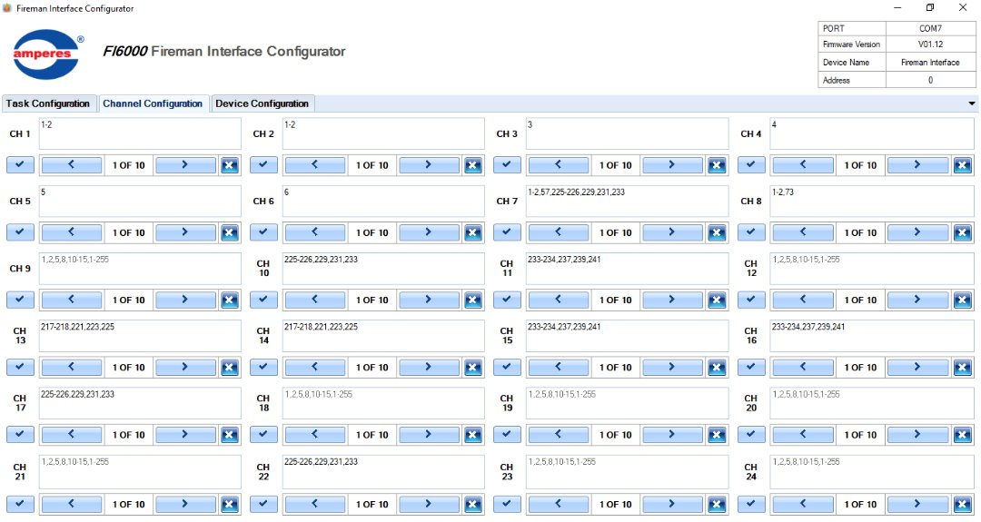
Amperes FI6000 - Programming Channel

Slide 8
Amperes FI6000 - What it can offer
Define which zone to activate whenever a trigger is received. ie. Zone 1 activated shall enable a broadcast to zone 2,3 and 4
Tasks / sequence of events whenever a zone is triggered is programmable
Able to trigger more specific event ie. to trigger which message to play, duration of playback, delay, zone selection, etc

Slide 9
Amperes FI6000 - Upcoming Upgrade ( Mid 2021 )
Web based User Interface for ease of programming, firmware updates and no application software download is required
Simpler Master and Slave setup for larger configurations, also enable easier Firmware upgrades and setup
Dual mode activation setup : Channel - Zone Config / Task - Zone Config
Readily compatible with PMX LAN for monitoring purpose

Slide 10
VORAUS Series - A PREMIUM LEVEL from

